Slide 1
Action points retrieval from meeting transcription

Slide 2
Case Study Project: Action points retrieval
Challenges
Solution
Technology
Benefits
Manual scribing of minutes of meetings.
Missing out on decisions & action points Missing the follow-up on action points No means to go back to the meeting conversation.
Artificial Intelligence is able to identify action plans and automatically extract them from your meeting minutes
Implement solution to extract or record meeting audio from meeting platforms.
Using Azure cognitive services to generate meeting transcript form audio.
Minutes of meeting and action points are classified using AI & NLP deep learning technologies.
Azure Speech Services.
Python, Pytorch, Transformer based SOTA models.
Accurate recording of the meeting & opportunity to replay, Auto-follow-up of action points.
Items classified as decisions, action points & keynotes
Clear determination of ownership & commitments

Slide 3
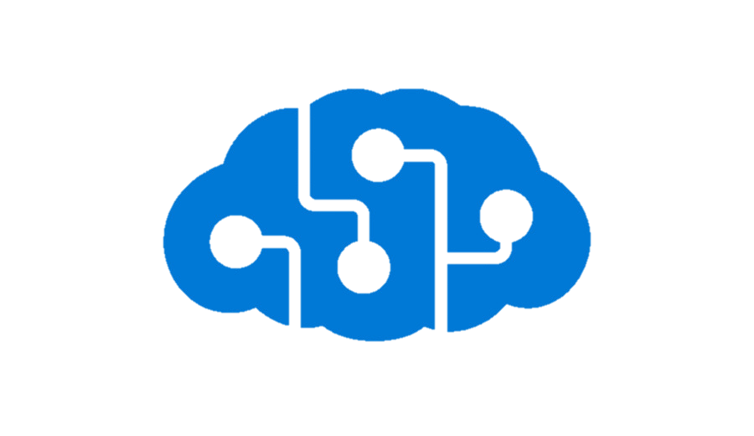
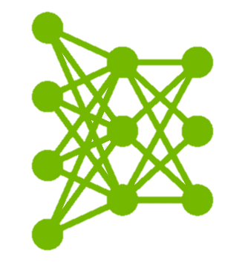
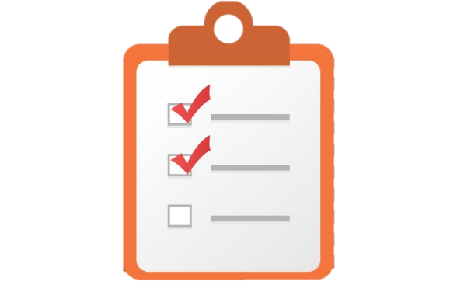

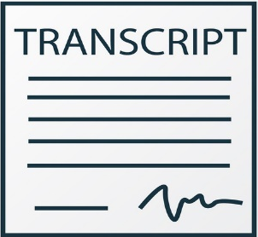

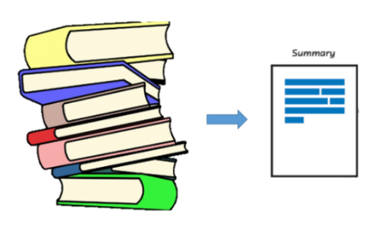
Project flow
Meeting
API cognitive services or plugins to convert meeting audio to transcript
Transcription
Deep Learning model
Extracting action points
Mail to all the participants
Summarization

Slide 4
Future research & implementation
Implementing and improving speaker diarization i.e. task of identifying the start and end time of a speaker in an audio file, together with the identity of the speaker i.e. who spoke when. It can enhance the readability of an automatic speech transcription by structuring the audio stream into speaker turns and by providing the speaker’s true identity.
To develop plugin version for browsers.

